Slide 1
Lesson 15 Full Stack NFT Marketplace

Slide 2
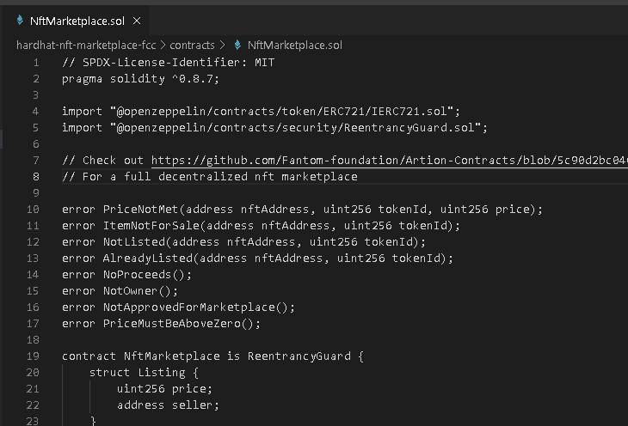
Contracts

Slide 3
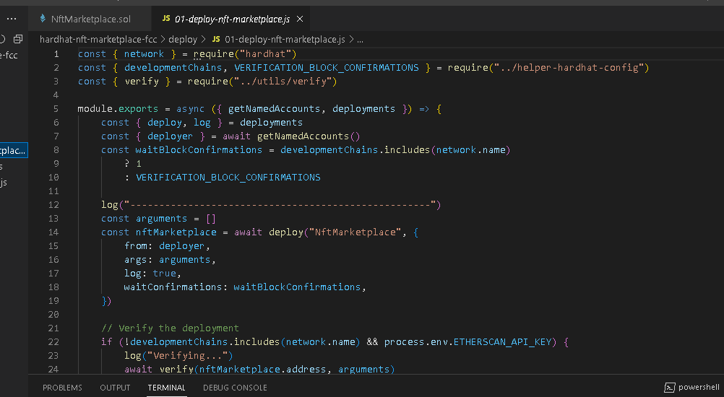
NFT Marketplace Deploy

Slide 4
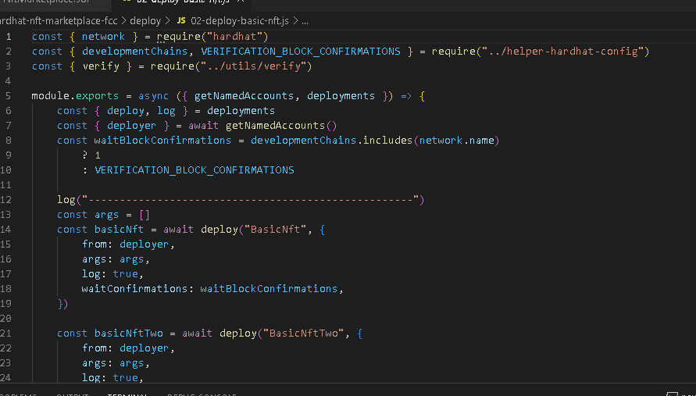
NFT Basic Deploy

Slide 5
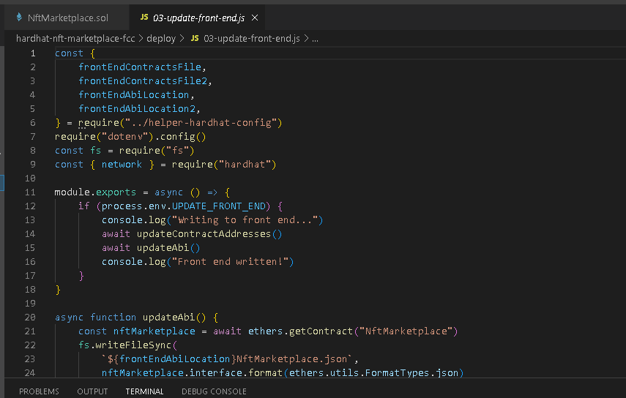
Update Front End

Slide 6
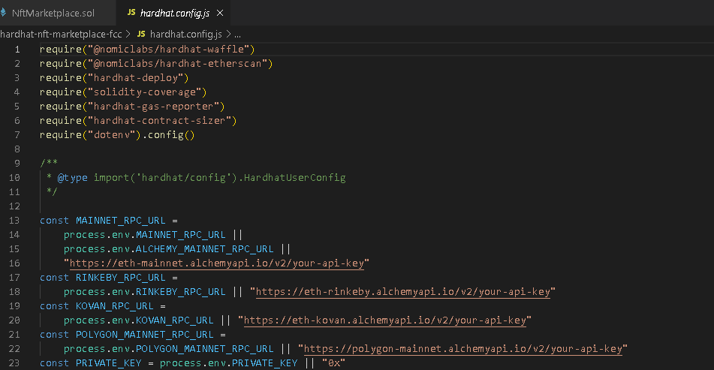
Hardhat Config

